Slide 1
Database Management (DBAS32100)

Slide 2
Introduction to PL/SQL
Walid Belal

Slide 3
What is pl\sql?
PL stands for procedural Language and PL\SQL is an extension to SQL that allows use programing techniques to extend the usefulness of SQL. In other words PL\SQL is a programming language that in integrated with Oracle’s SQL

Slide 4
PL/SQL Basic block formation
DECLARE
BEGIN
EXCEPTIONS
END;
Declaration Area
Body Area
Exception Handling Area

Slide 5
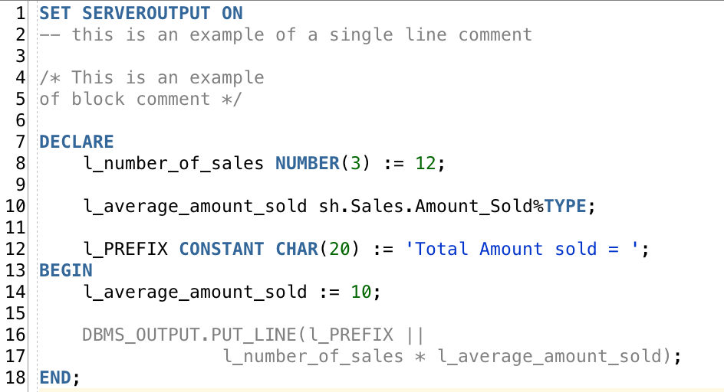
Variable and Constants declaration
Variables and constants are declared in the declaration part of PL/SQL block
A data type can be explicitly specified for a variable, or implicitly by specifying the type of a table column to the variable
Constant keyword is used to specify a constant

Slide 6
Variable and Constant Assignment
:= operator is used for variable assignment
In the declaration statement
In the body area

Slide 7
PL/SQL coding Style
Semicolon ends a sentence
Write commands in Upper case and variables in lower case with _ between words
Use Indentation
Use comments (-- for line comment & /* */ for block comment)
Write one sentence per line
If a sentence is too long then spread it on more than one line with indentation

Slide 8
Data Types
SQL Character Data Types (CHAR, NCHAR, VARCHAR2, NVARCHAR2, CLOB, NCLOB) Link to Oracle
SQL Number Data Types (NUMBER) Link to Oracle
Boolean Link to Oracle
PLS_Integer, Simple_Integer Link to Oracle
User Defined Link to Oracle

Slide 9
CONTROL Statements
IF Statement
CASE Statement
Loops
FOR
WHILE

Slide 10
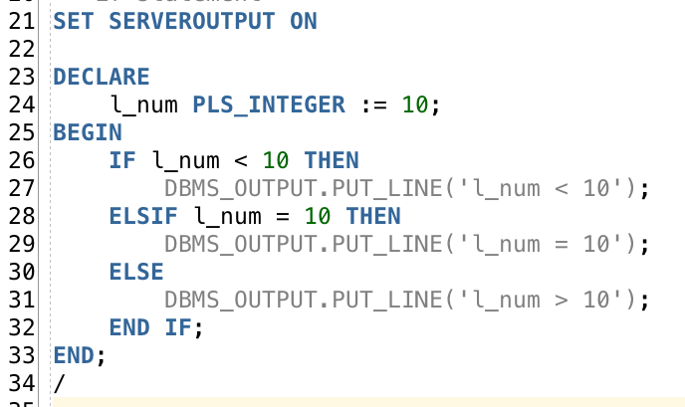
IF Statement
IF Condition THEN
Statement(s);
ELSIF Condition THEN
Statement(s);
ELSE
Statement(s);
END IF;

Slide 11
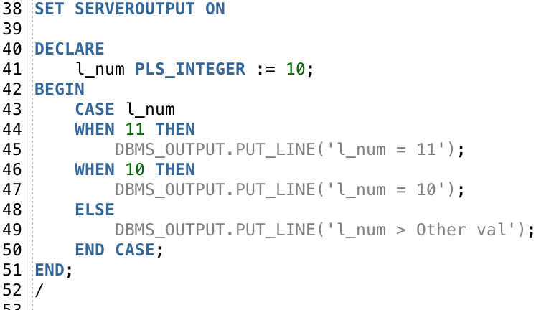
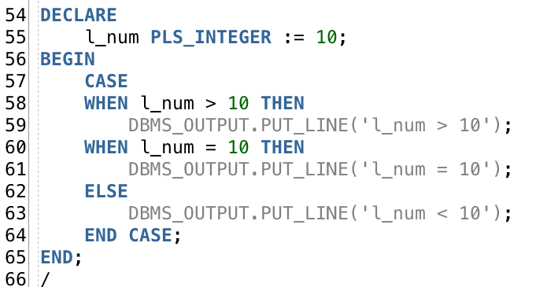
case Statement
CASE
WHEN Condition THEN
Statement;
[Statement(s)]
[WHEN Condition THEN
Statement;
[Statement(s)]]
[ELSE
Statement;
[Statement(s)]]
END CASE;
Notes:
Difference between case and if. Case must return value while if does not have to

Slide 12
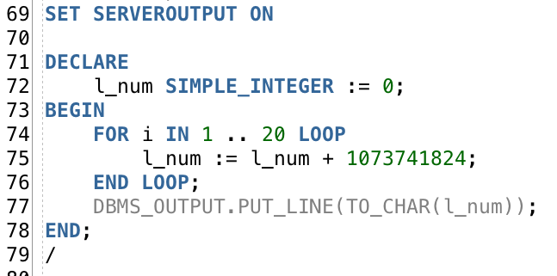
FOR loop statement
FOR Variable IN [REVERSE] Start Val .. End Val
LOOP
Statement (s) ;
END LOOP;

Slide 13
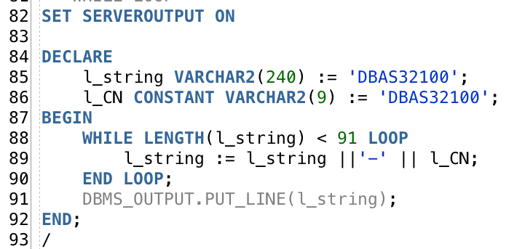
While loop statement
WHILE Condition
LOOP
Statement;
[Statement(s)]
END LOOP;
This is a concatenation

Slide 14
A
Practice
20 Minutes
Create a PL/SQL block that will print to screen all the odd numbers between 1 and 100
hint: use MOD(dividend, divisor) Function

